Slide 1
Detect Obstacles and Notify
電機六 B03208039 鐘友隸
June 25, 2021

Slide 2
Contents
Introduction
Hardware
Software
Demo
Discussion
Future Work

Slide 3
Introduction
Detect obstacles on road
Change drive settings of cars when cars get close to the obstacle

Slide 4
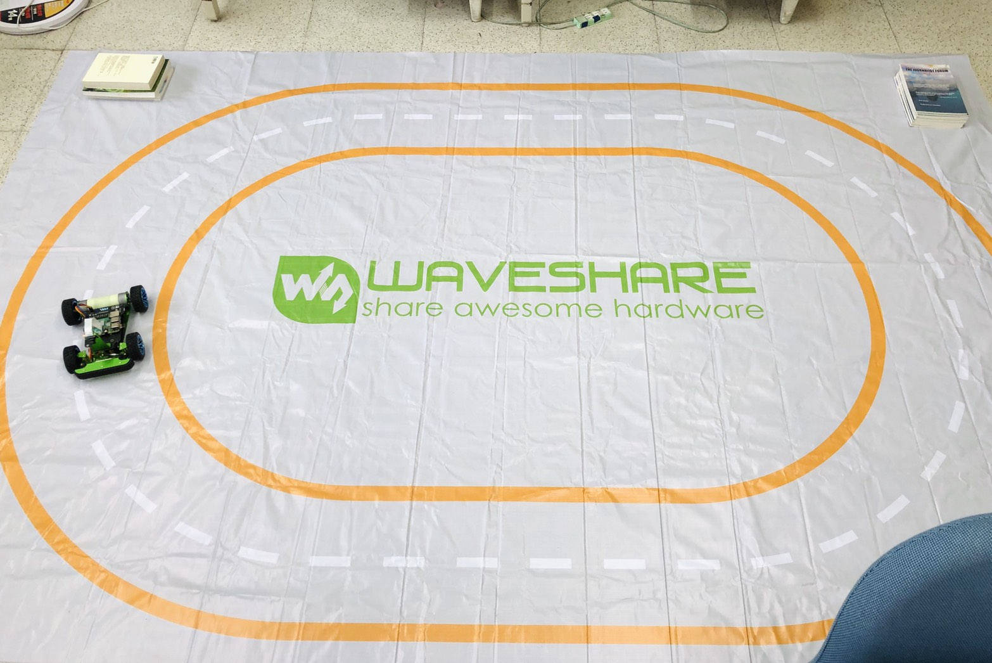
Hardware
Laser Ranging Sensor
Ultrasonic Ranging Module
Obstacle

Slide 5
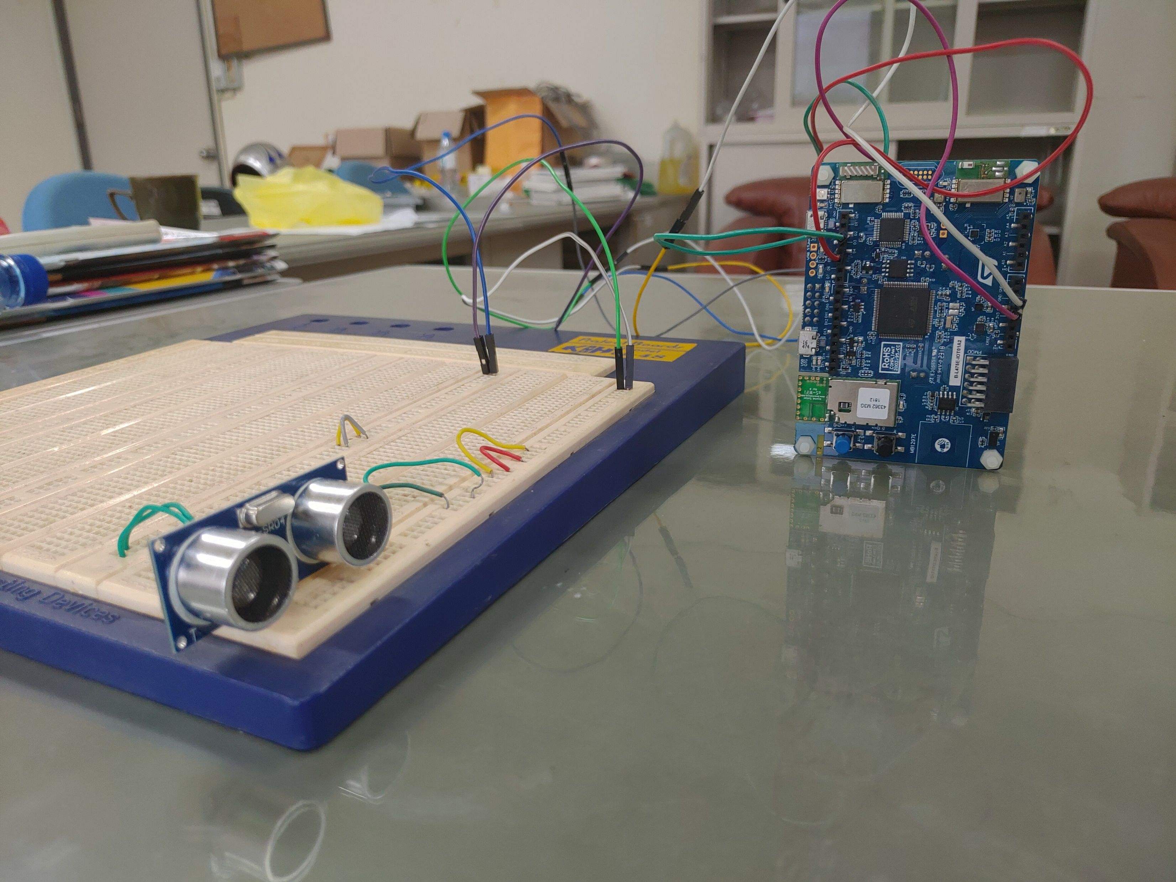
Hardware
B-L475E-IOT01A
VL53L0X (onboard)
HC-SR04
Raspberry Pi 4 B (car)

Slide 6
Software: Overview
STM32
Send socket (car, obs, dist) when carExistence changes
If carExistence == True, carExistence = False after 10 (or 5) seconds
Raspberry Pi
isCar & isObstacle: Manual
isCar & ~isObstacle: Auto
~isCar: Auto

Slide 7
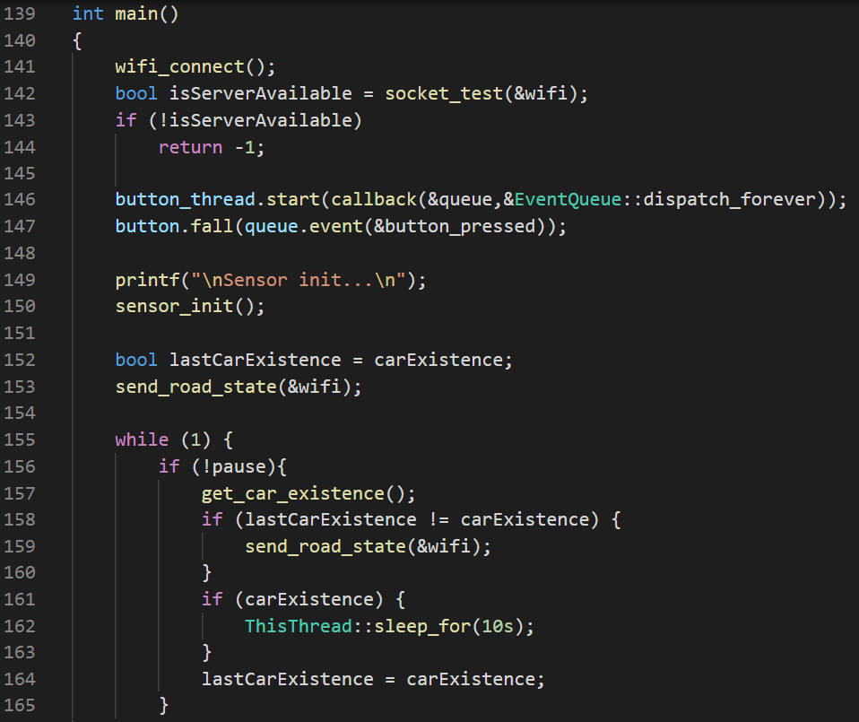
Software: STM32
Libraries
Mbed OS 6.12.0
wifi-ISM43362
HCSR04 (modified)
VL53L0X (modified)
scan_demo() fails for 6.12

Slide 8
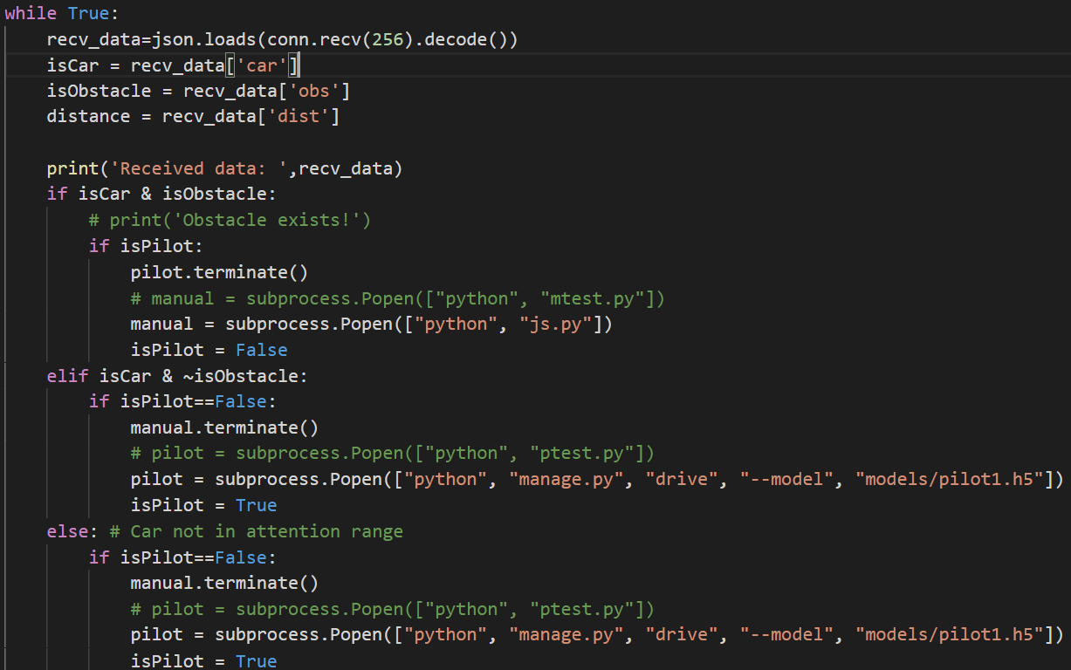
Software: Raspberry Pi
Socket Server
Subprocess: too slow
Drive mode (failed)

Slide 9
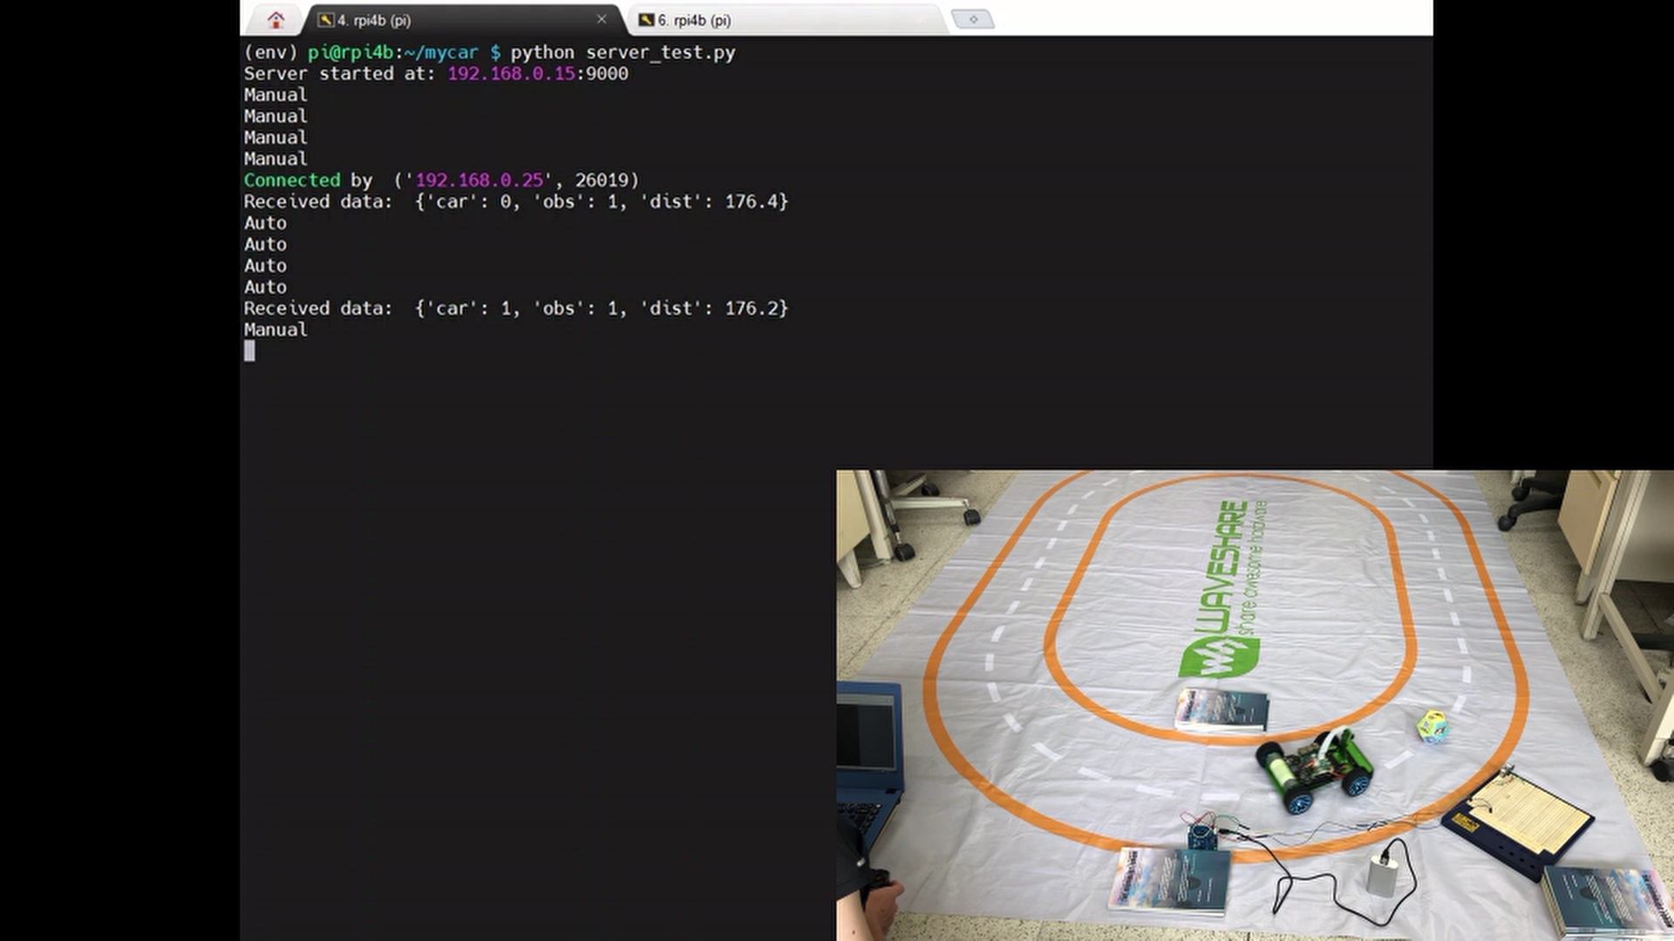
Demo: server_test.py

Slide 10
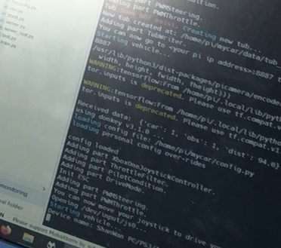
Demo: server.py

Slide 11
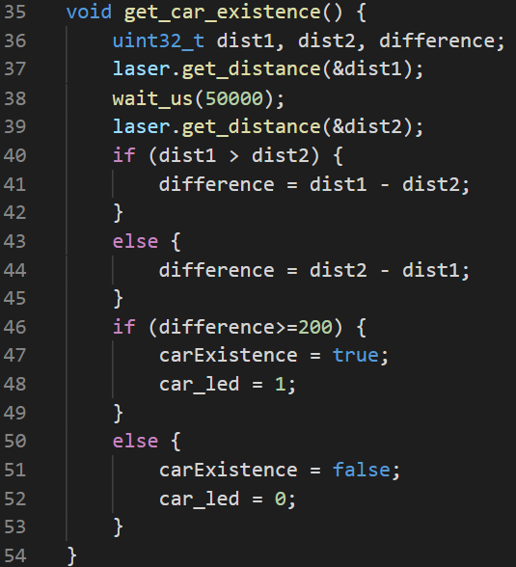
Discussion
Ultrasonic ranging module is quite stable
However, its scanning angle is small
Laser ranging sensor needs tuning
Scanning angle is also small
Still unable to control drive mode directly
Workaround failed
All functions in main()
Not familiar with donkey car

Slide 12
Future Work
Other sensing method
Car passed obstacle
Faster response
Now: Receive obstacle and position information passively
Car knows its position, read obstacle information actively when entered obstacle detection range

